Slide 1
INTERFACING THE ADS1210 CONVERTER WITH AN ATmega8535 MICROCONTROLLER
Author: Eng. Magnelli Luca

Slide 2

Index
Project Objectives
ADS1210: 24-bit ADC Σ-Δ
Hardware Connections – Three Wire
AVR Assembler Program Flowchart
  Main Body
  Interrupt Data_Ready
Results
  RESET sequence – timing
  Serial interface – timing
  Conclusions

Slide 3
Project Objectives
Serial sinchronous interface between ADS1210 and ATmega8535
  Based on ADC serial interface timing
  Useful for sending commands and data receiving
Commmands transmission to ADC from keyboard
  PC – ATmega8535 interface: USART
Send the converted data to the screen in Volts

Slide 4
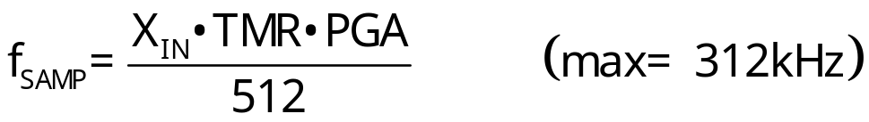
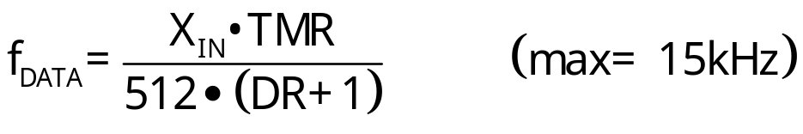
ADS1210: 24-bit ADC Σ-Δ
Effective Resolution: 23-bits@10Hz e 20-bits@1kHz
On chip self-calibration
Internal/External Reference (V_{REF})
Programmable Gain Amplifier (PGA)
Turbo Mode (TMR, aumenta f_{SAMP})
Digital filter programmabile
  Decimation Ratio (DR) può variare tra 19 e 8191
High Resolution
  Measurement application, strumentazione, pressure and temperature transducers, industrial process control

Slide 5
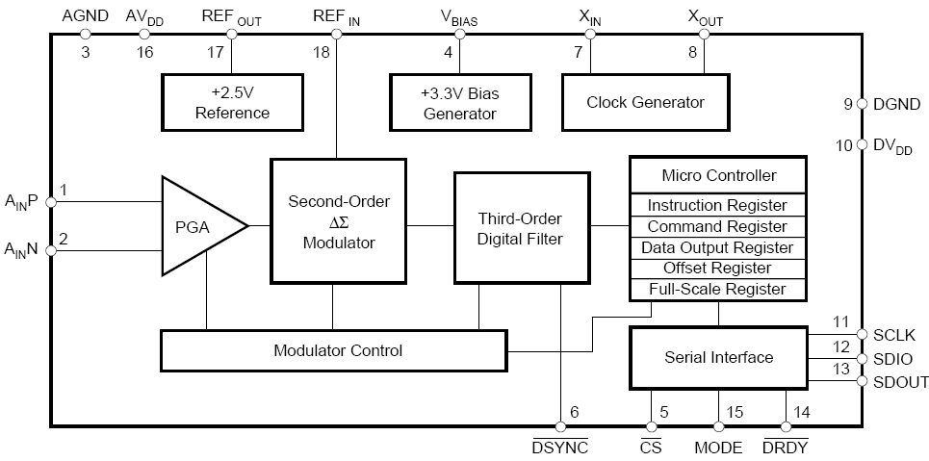
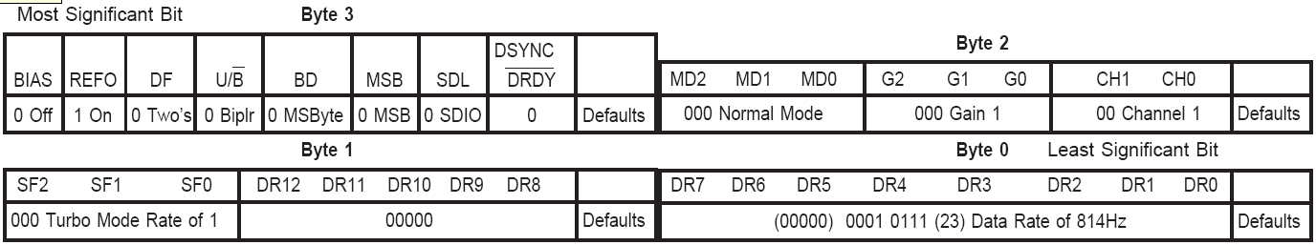
ADS1210: 24-bit ADC Σ-Δ
Internal MicroController
  Registers: INSR, CMR, DOR, Calibration
Serial Interface (Master/Slave MODE)

Slide 6

Hardware Connections – Three Wire
Digital Supply: V_{TG} (5V) e GND – STK500
Analog Supply: A_{REF} (5V) e GND – ATmega8535
X_{IN}=3.6864MHz – STK500
ADS1210 in Slave MODE
Serial Interface ATmega8535 – ADS1210
  SDIO<->PB5, SCLK <-PB7, -> PD2 (INT0)
Serial Interface ATmega8535 – PC
  PD0 (RXD)<->RXD (RS232 SPARE – STK500)
  PD1 (TXD)<->TXD (RS232 SPARE – STK500)

Slide 7
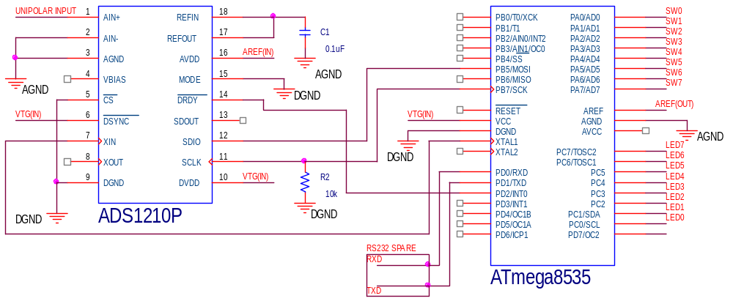
Hardware Connections – Three Wire

Slide 8
Main body
Set Up
Write CMR3:0 on
ADS1210
Enable Data_Ready
Interrupt on
falling edge of DRDY
Has been received
a character in UDR
via USART?
N
Y
Receive new configuration
via USART and send it
to ADS1210

Slide 9
Interrupt Data_Ready
DRDY Falling edge
(external interrupt 0 enabled)
Read
DOR2:0 from
ADS1210
Load counters
10⁰_10⁻¹_10⁻²_10⁻³_10⁻⁴_10⁻⁵_10⁻⁶
with values converted in Volts
Transmit the value converted
in Volts to PC via USART
Exit from interrupt

Slide 10
Set Up
Load SRAM
  Comparison values for V_{FS}=5, 2.5, 1.25V
  Counters for binary data conversion
  t_{IN} cycles for the RESET sequence
Transmit RESET sequence on SCLK
Initializing USART
  Baud rate=115.2kbps, 8-bit data, 2 stop bits
Enable External Interrupt 0 for Data Ready
  Interrupt on falling edge of INT0
Load initial values on INSR e CMR3:0
  Bias off, REF_{out}, 2’s complement, Bipolar bit, MSByte ed MSB first, Normal mode, Gain=1, TMR=16, Decimation Ratio=8191
f_{SAMP}=115.3kHz e f_{DATA}=14.1Hz @ X_{IN}=3.69MHz

Slide 11
Write CMR3:0 on ADS1210
ADS1210 is in
Sleep Mode?
Y
N
DRDY
Falling edge?
N
Y
ATmega8535 generates
8 serial clock and
transmit INSR via SDIO
Enable Data_Ready
Interrupt on
falling edge of DRDY
in Main Body
or
Transmit to PC via
USART: Line Feed
and Carriage Return
In: Receive new configuration
via USART and send it
to ADS1210 (1)
ATmega8535 generates
32 serial clock and
transmits CMR3:0 via SDIO
ADS1210 takes
DRDY HIGH

Slide 12
Receive new configuration via USART and send it to ADS1210 (1)
Has been received a
new character in UDR
via USART?
Disable External
Interrupt 0
Y
N
Y
Y
N
N
First is ‘m’?
Second is ‘0’?
Second is ‘1’?
Second is ‘6’?
Y
Y
Y
N
N
Normal Mode
Self Calibr.
Sleep Mode
N
Y
N
N
First is ‘g’?
Second is ‘1’?
Second is ‘2’?
Second is ‘3’?
N
Y
Y
Y
Gain=1
Gain=2
Gain=4
N
Y
N
N
First is ‘t’?
Second is ‘1’?
Second is ‘2’?
Second is ‘3’?
N
Y
Y
Y
TMR=16
TMR=8
TMR=4

Slide 13
Receive new configuration via USART and send it to ADS1210 (2)
First is ‘d’?
N
SI
II is 1?
Y
N
DR=1FFF
Write CMR3:0 on
ADS1210
II is 2?
Y
DR=17F9
N
II is 3?
Y
Transmit to PC via
USART: Line Feed
and Carriage Return
N
DR=0FF5
II is 4?
Y
DR=03E9
N
II is 5?
Y
Save CMR2
Has been received
a character in UDR
via USART?
In: Main Body
N
DR=01FF
II is 6?
Y
Enable External
Interrupt 0
N
DR=0013

Slide 14
Read DOR2:0 from ADS1210
ATmega8535 generates
8 serial clock and
transmit INSR via SDIO
SDIO becomes output
Load counters
10⁰_10⁻¹_10⁻²_10⁻³
_10⁻⁴_10⁻⁵_10⁻⁶
with values converted
in Volts
in: Interrupt Data_Ready
ATmega8535 generates
24 serial clock and
receives CMR3:0 via SDIO

Slide 15
Load counters 10⁰_10⁻¹_10⁻²_10⁻³_10⁻⁴_10⁻⁵_10⁻⁶ with values converted in Volts (1)
Set to zero counters
10⁰_10⁻¹_10⁻²_10⁻³_10⁻⁴_10⁻⁵_10⁻⁶
Gain=1?
Y
N
Load in ZL the SRAM location of
LSByte comparison binary code of
1V with V_{FS}=5V
Gain=2?
Y
N
Load in ZL the SRAM location of
LSByte comparison binary code of
1V with VFS=2.5V
Load in ZL the SRAM location of
LSByte comparison binary code of
1V with VFS=1.25V
Load in XL the SRAM location
of counter 10⁰

Slide 16
Load counters 10⁰_10⁻¹_10⁻²_10⁻³_10⁻⁴_10⁻⁵_10⁻⁶ with values converted in Volts (2)
The number in DOR0:2 (24bit) is
lower than the comparison code?
Y
N
Increase the counter value
Subtract to DOR0:2
the comparison code
Increase XL
XL point at the SRAM location
next to counter 10⁻⁶?
Y
Transmit the value
converted in Volts to
PC via USART
in: Interrupt
Data_Ready
N
Load in ZL the SRAM location of
LSByte comparison code equals to
the previous/10

Slide 17
Transmit the value converted in Volts to PC via USART (1)
Load in ZL the SRAM location
of the counter 10⁰
Y
Send temp register
to PC via USART
Counter=9?
N
Y
temp register<=9 ASCII
Counter=8?
Has been sent
counter 10⁰?
NO
N
Y
temp register<=8 ASCII
Counter=7?
SI
N
Y
temp register<=7 ASCII
Counter=6?
Send to PC via
USART: . ASCII
N
Y
temp register<=6 ASCII
Counter=5?
N
Y
temp register<=5 ASCII
Increase ZL
Counter=4?
N
Y
temp register<=4 ASCII
ZL point at the
SRAM location next to
counter 10-6?
Counter=3?
N
Y
temp register<=3 ASCII
SI
Counter=2?
N
Y
temp register<=2 ASCII
Counter=1?
NO
N
temp register<=1 ASCII
temp register<=0 ASCII

Slide 18
Transmit the value converted in Volts to PC via USART (2)
Send to PC via
USART: space and V
ASCII
Send to PC via
USART: Line feed
and Carriage Return
Exit from interrupt
in: Interrupt Data_Ready

Slide 19
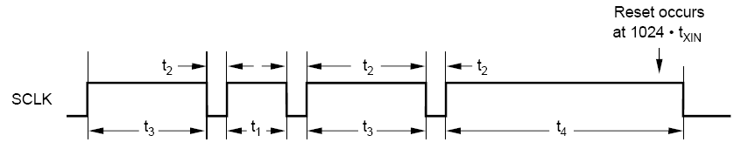
RESET sequence – timing
ADS1210 RESET
  Sequence on PB7->SCLK
  t₁=82.4µs =304 t_{IN} (>256 e <400 t_{IN})
  t₂=3.78µs =14 t_{IN} (>5.5 t_{IN})
  t₃=163µs =601 t_{IN} (>512 e <900 t_{IN})
  t₄=286µs =1055 t_{IN} (>1024 e <1200 t_{IN})

Slide 20
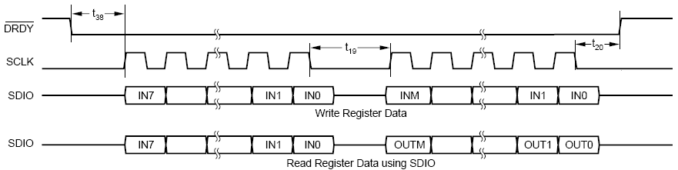
Serial interface – timing
ADS1210 Receives
  f_{SCLK}=227.3kHz =X_{IN}/16
  t₃₈=6.36µs =23t_{IN} (>5.5t_{IN})
  t₁₉=3.8µs =14t_{IN} (>5.5t_{IN})
  t₂₀=1.42µs =5t_{IN} (>4t_{IN})
ADS1210 Transmits
  f_{SCLK}=263.2kHz =X_{IN}/14
  t₃₈=7.1µs =26t_{IN} (>5.5t_{IN})
  t₁₉=6.7µs =25t_{IN} (>5.5t_{IN})
  t₂₀=2µs =7t_{IN} (>4t_{IN})

Slide 21
Conclusions
ADS1210 offers:
  High Resolution
  Good flexibility
  … but low conversion speed
ATmega8535 after received 24-bits data has the time for:
  Execute arithmetic operations for data conversion in Volts
  Transmit data converted to PC
From the keyboard is possible to send 15 different instructions exploit the majority converter functions

Slide 22
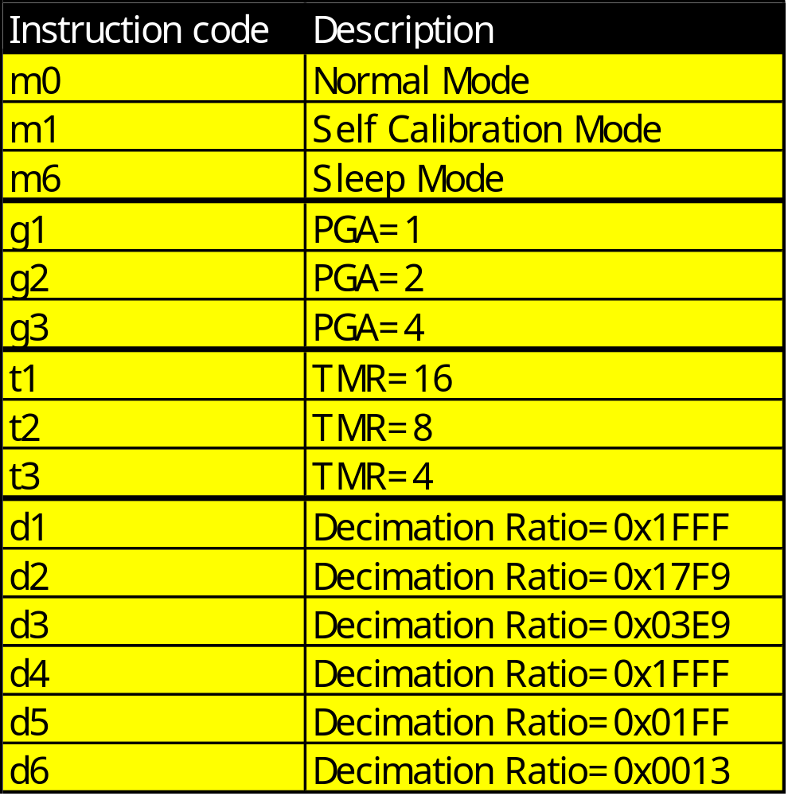
INSTRUCTION SET SUMMARY

